Slide 1
Lesson 26
Communication Services
Computer Literacy BASICS: A Comprehensive Guide to IC³, 4th Edition
Morrison / Wells

Slide 2
Objectives
Categorize electronic communication.
Identify users of electronic communication.
Identify components of electronic communication.
Manage e-mail with Microsoft Outlook.
Send and receive e-mail.
Save a message.
2
2

Slide 3
Vocabulary
Address Book
archiving
attachment
Contact Group
e-mail address
electronic mail (e-mail)
instant messaging
packet
save a message
signature
spam
text messaging
user agent
Windows Live Mail
3
3

Slide 4
Categorizing Electronic Communication
Electronic mail can be sent to other people on a network at an organization or you can use an Internet service provider to send e-mail to any computer in the world.
Instant messaging (IM) services send messages in real time.
Text messaging is using a cell phone or other mobile device to send and receive written messages.
4
4

Slide 5
Categorizing Electronic Communication (continued)
Voice over IP (VoIP) is used to make phone calls with an Internet connection instead of a regular telephone line.
Online conferencing allows you to conduct a conference with yourself and one or more other participants at different sites by using computer networks to transmit audio and video data.
5
5

Slide 6
Categorizing Electronic Communication (continued)
Chat rooms are Web sites that allow real-time communication so you can exchange messages with others through the computer.
Social networking sites provide a way to build online communities of people who share common interests or activities.
Blog postings/comments are a type of personal journey created by one person or by a group.
6
6

Slide 7
Categorizing Electronic Communication (continued)
Message boards and newsgroups are services that provide bulletin board systems that serve as discussion sites; users can post messages asking for assistance.
7
7

Slide 8
Identifying Users of Electronic Communication
Millions of people use the Internet, and each is required to have unique identification in the form of an e-mail address, sign-in or logon credentials, and password in the same way that each person has a unique phone number.
8
8

Slide 9
Identify Components of Electronic Communication
Electronic communication is the technology that enables computers to communicate with each other and other devices.
In 1969, ARPANET was established and served as a testing ground for new networking technologies.
ARPANET was a large wide area network created by the United States Defense Advanced Research Project Agency (ARPA).
9
9

Slide 10
Identify Components of Electronic Communication (continued)
Today’s electronic communication requires the following components:
  Software
  Sender
  Receiver
  Channel
  Communication
  Protocols
10
10

Slide 11
Identify Components of Electronic Communication (continued)
Interpreting E-Mail Addresses:
An e-mail address consists of three parts:
  The user name
  The @ symbol
  The user’s domain name
Domain codes include .com, .edu, .gov, .mil, and .org.
11
11

Slide 12
Identify Components of Electronic Communication (continued)
Parts of an E-Mail Message:
An e-mail message should contain four main components:
  The address of one or more people to whom you are sending the message
  A subject line
  The body of the message
  Attachments should be noted in the body of the message
12
12

Slide 13
Identify Components of Electronic Communication (continued)
E-Mail Options:
Reply to Sender sends the reply along with the original message.
Reply All sends your message to everyone listed in the To or From line of the e-mail message.
Forward sends a message to people other than those who sent the original message.
13
13

Slide 14
Identify Components of Electronic Communication (continued)
E-Mail Options (continued):
Courtesy copy (Cc) and blind copy (Bcc) sends a copy of an e-mail to another person. The recipient of a Bcc is not visible to the other people receiving the message.
When you send someone an e-mail message, it is broken down into small chunks called packets that travel independently from server to server to speed the process.
14
14

Slide 15
Identify Components of Electronic Communication (continued)
Accessing E-Mail:
Many Web sites and Internet service providers offer e-mail as part of a monthly fee or even at no charge.
Many people have cell phones or handheld computers that can send and receive e-mail almost anywhere.
15
15

Slide 16
Managing E-Mail with Microsoft Outlook
Outlook is a versatile application that you can use to organize appointments, tasks and to-do lists, addresses, and e-mail.
Outlook is similar to Windows Live Mail, an e-mail program provided free of charge from the Windows Live Web site.
16
16

Slide 17
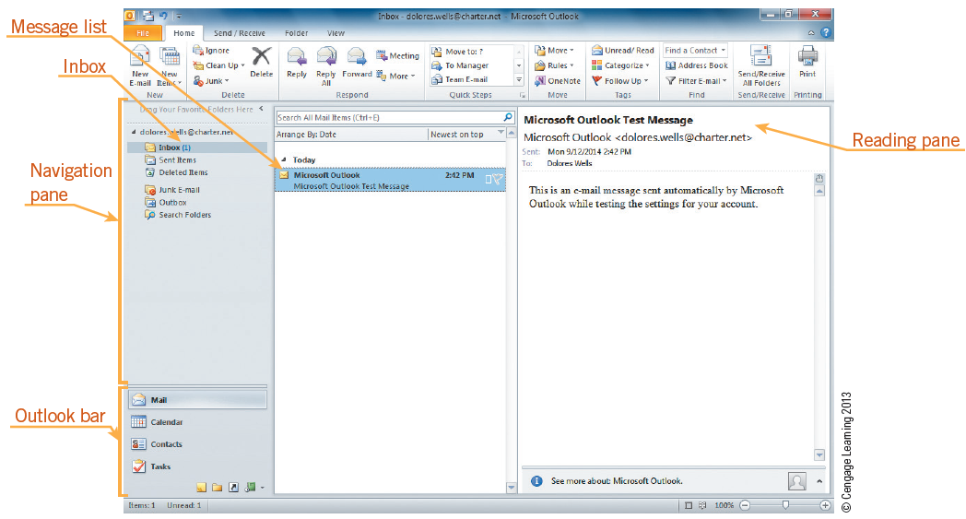
Managing E-Mail with Microsoft Outlook (continued)
When you start Outlook, the default opening window is the Outlook Today window.
17
17

Slide 18
Managing E-Mail with Microsoft Outlook (continued)
Using the Inbox, you can organize your mail by creating mail folders for various topics, special projects, and individuals.
You can create and delete folders and move or copy e-mail messages into folders.
You can delete e-mail messages, search for messages within a folder, and sort messages by date.
Archiving is the process of backing up e-mail messages.
18
18

Slide 19
Sending and Receiving E-Mail
An advantage to using Outlook as your e-mail application is that as you create messages, you have easy access to the other Outlook features.
Receiving E-Mail:
When you open Outlook, it sends a request to your mail server to check if you have any messages waiting. If you do, Outlook receives them and displays them in the Inbox folder.
19
19

Slide 20
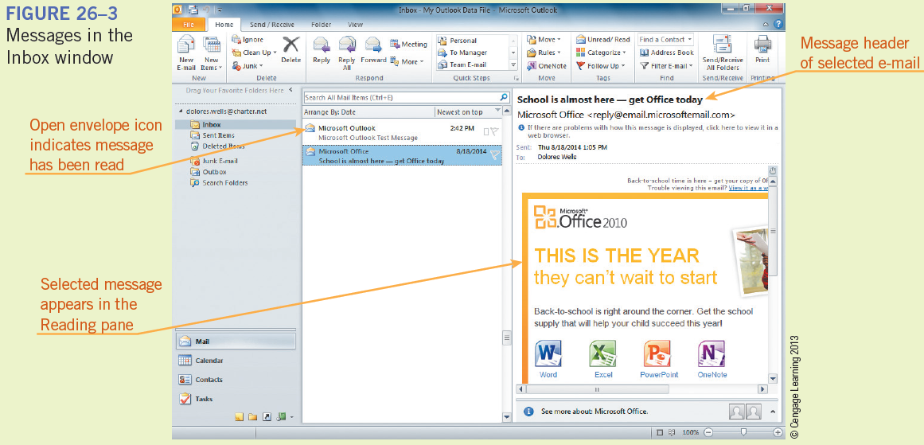
Sending and Receiving E-Mail (continued)
Receiving E-Mail (continued):
The message header tells you who sent the message, the subject of the message. The Reading pane displays the actual text of the message.
20
20

Slide 21
Sending and Receiving E-Mail (continued)
E-Mail Features:
The Outlook Address Book stores names, e-mail addresses, phone numbers, and other contact information so you can easily access it while you are sending and receiving e-mail messages.
You can use a Contact Group to send the same e-mail to a group.
21
21

Slide 22
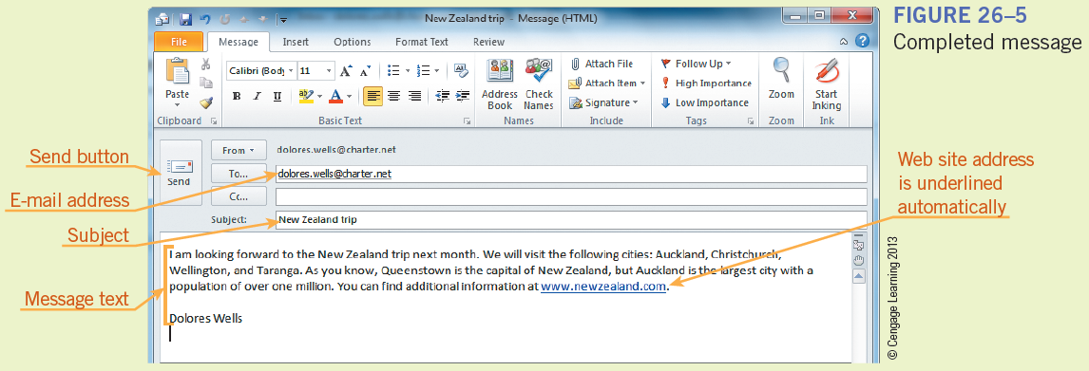
Sending and Receiving E-Mail (continued)
Sending E-Mail:
Enter an e-mail address in the To text box.
Include a subject.
Enter the text.
Click Send.
22
22

Slide 23
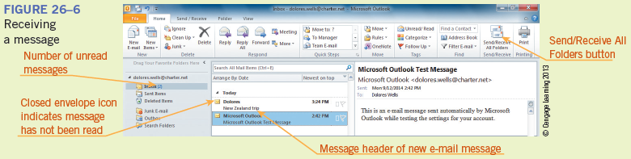
Sending and Receiving E-Mail (continued)
Receiving and Opening E-Mail Messages:
Click the Send/Receive All Folders button in the Send/Receive group on the Home tab.
23
23

Slide 24
Saving a Message
You can save a message as a draft, a file in another format such as a text file, an HTML document, or a template using the Save As dialog box.
Most people reply to messages they receive and save important messages for future reference.
You might want to delete unneeded messages and spam. Spam is unsolicited e-mail, essentially electronic junk mail.
24
24

Slide 25
Saving a Message (continued)
Replying to a Message:
Select the message, click the Reply or Reply All button in the Respond group on the Home tab, type your response, and click Send.
Formatting a Message:
You can change the font type, font size, and text color of an e-mail message. You can also add bold, italic, and underline styles to text as well as center it and add bullets.
25
25

Slide 26
Saving a Message (continued)
Attaching a File to an E-Mail Message:
Attachments are documents, images, figures, and other files that you can attach to your e-mail messages.
Click the Attach File button in the Include group on the Message window Ribbon, locate the file or document you want to attach in the Insert File dialog box, and then click the Insert button.
26
26

Slide 27
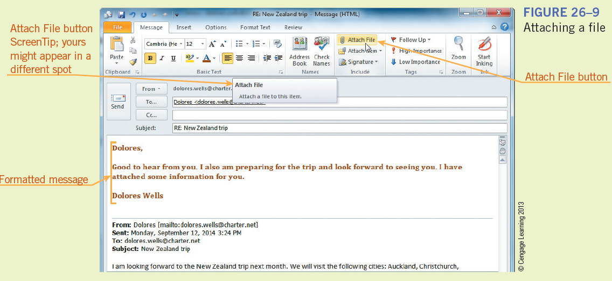
Saving a Message (continued)
Attaching a File to an E-Mail Message (continued):
27
27

Slide 28
Saving a Message (continued)
Managing Attachments:
When you receive an attachment, you can:
  Preview it by clicking the attachment in the Message window to display the contents in the Reading pane
  Open the attachment by double-clicking it in the Message window
  Save the attachment by right-clicking it, clicking Save As on the shortcut menu
  Remove the attachment by right-clicking it and clicking Remove Attachment on the shortcut menu
28
28

Slide 29
Saving a Message (continued)
Message Icons:
Icons in the message headers in the message list offer clues about each message.
  A sealed envelope icon indicates a message that has been received but not read.
  An exclamation point means the sender considers it an urgent or high-priority message.
  A paper clip indicates that the message has an attached file.
  A flag icon is a reminder to follow up.
29
29

Slide 30
Saving a Message (continued)
Copying to Multiple Recipients:
You can insert more than one address in the To, Cc, and Bcc boxes to send to all the addresses at the same time.
Each e-mail address should be separated by a semicolon.
30
30

Slide 31
Saving a Message (continued)
Mail Configuration Options:
You can configure Outlook to deal automatically with e-mail:
  Automatic “out of the office” response replies to all e-mail messages when you are unable to reply yourself.
  Forwarding command automatically redirects your mail to another e-mail address
  Redirect messages to your mobile phone
  Block Senders List prevents messages from designated addresses from being placed in your Inbox
  Safe Senders/Safe Recipients List accepts all e-mails from the sender names contained in the list.
31
31

Slide 32
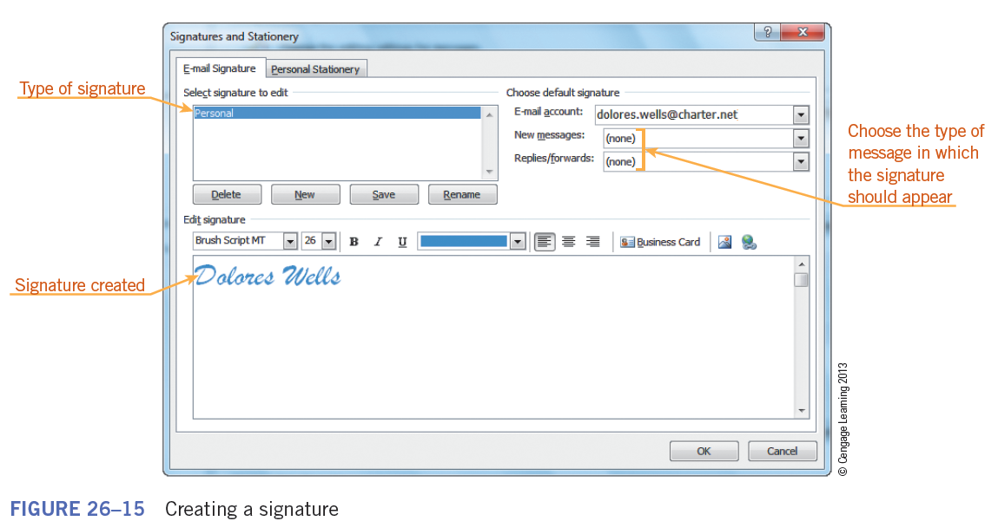
Saving a Message (continued)
Mail Configuration Options (continued):
A signature consists of text or pictures that you create so Outlook can add it to the end of any outgoing messages
32
32

Slide 33
Summary
In this lesson, you learned:
Electronic communication includes e-mail, instant messages, text messages, VoIP phone calls, online conferences, chat rooms, blogs, and social networks.
The components of electronic communication include software, a sender, a receiver, a channel, communication content, and protocols.
33
33

Slide 34
Summary (continued)
Wireless communication makes it possible to send and receive e-mail using a handheld computer or cell phone with e-mail capabilities.
E-mail addresses consist of three parts: the user name, the @ symbol, and the domain name.
Microsoft Outlook includes features to manage appointments, tasks, and e-mail. The Outlook bar displays shortcuts that give you quick access to each of the Outlook folders.
34
34

Slide 35
Summary (continued)
Electronic mail is similar to regular mail because it requires an address, a message, and a carrier to get it from the sender to the receiver.
You can access e-mail on a computer using a program such as Microsoft Outlook, or you can send and receive e-mail messages using a Web site with a built-in e-mail program, such as Gmail or Hotmail.
An e-mail message header includes the address of the recipient, the subject of the message, and information about to whom the message is sent as a copy.
35
35

Slide 36
Summary (continued)
You can use the Inbox folder in Outlook to send and receive e-mail messages.
An attachment is a file that is sent with an e-mail message and that can be opened by the recipient.
You can reply to an e-mail message, forward a message to a new recipient, delete a message, or save a message.
Spam, or junk e-mail, consists of unsolicited messages that take up space in your Inbox unnecessarily.
36
36

Slide 37
Summary (continued)
E-mail messages are organized in folders of incoming messages, sent messages, deleted messages, and junk e-mail. You can also create additional folders to organize your own e-mail.
Special e-mail features let you add an automatic signature to messages, block messages from certain addresses, create personalized stationery for your messages, set up an automatic response, or forward your messages to another address.
37
37

